Slide 2
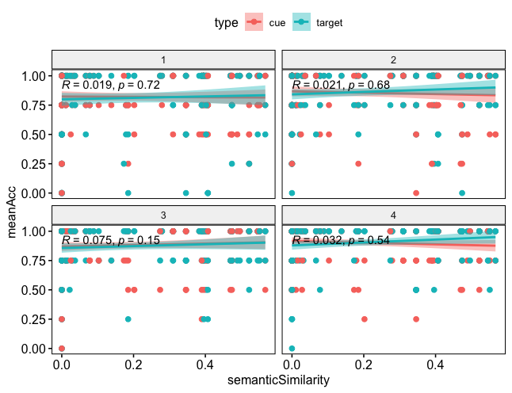
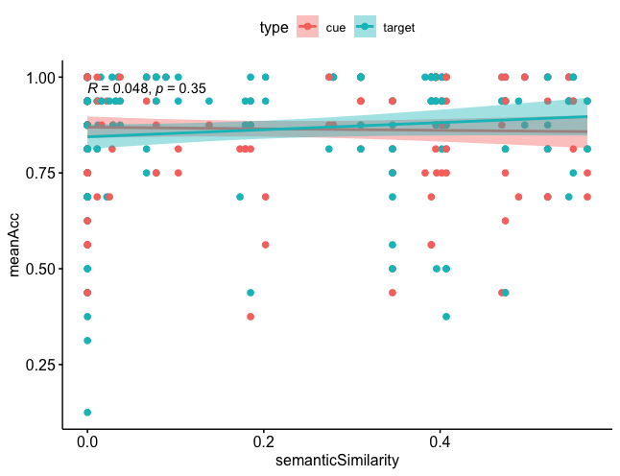
Regression analysis : semantic similarity level as a predictor for the Cover Task Acc. n = 47
Over 4 quartiles
Type III Analysis of Variance Table with Satterthwaite's method
Sum Sq Mean Sq NumDF DenDF F value Pr(>F)
type 0.031451 0.031451 1 326.07 1.410 0.2359
semanticSimilarity 0.018892 0.018892 1 350.40 0.847 0.3580
type:semanticSimilarity 0.050680 0.050680 1 326.07 2.272 0.1327
Type III Analysis of Variance Table with Satterthwaite's method
Sum Sq Mean Sq NumDF DenDF F value Pr(>F)
q 0.71785 0.71785 1 1450.0 16.8432 4.286e-05 ***
type 0.01108 0.01108 1 1450.0 0.2600 0.6102
semanticSimilarity 0.00356 0.00356 1 1459.7 0.0835 0.7727
q:type 0.00187 0.00187 1 1450.0 0.0440 0.8339
q:semanticSimilarity 0.00292 0.00292 1 1450.0 0.0685 0.7936
type:semanticSimilarity 0.00957 0.00957 1 1450.0 0.2246 0.6357
q:type:semanticSimilarity 0.00887 0.00887 1 1450.0 0.2082 0.6483

Slide 3
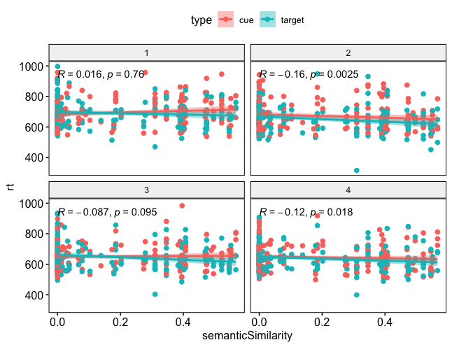
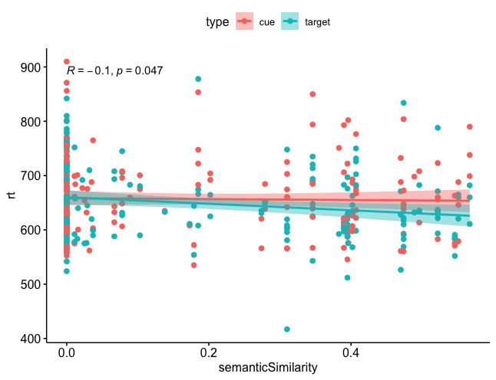
Regression analysis : semantic similarity level as a predictor for the Cover Task RT. n = 47
Type III Analysis of Variance Table with Satterthwaite's method
Sum Sq Mean Sq NumDF DenDF F value Pr(>F)
type 139.5 139.5 1 325.98 0.0390 0.84363
semanticSimilarity 11861.9 11861.9 1 337.88 3.3131 0.06961 .
type:semanticSimilarity 10478.5 10478.5 1 325.98 2.9267 0.08808 .
Type III Analysis of Variance Table with Satterthwaite's method
Sum Sq Mean Sq NumDF DenDF F value Pr(>F)
type 2342 2342 1 1432.3 0.3779 0.53884
q 208248 208248 1 1432.2 33.5975 8.324e-09 ***
semanticSimilarity 0 0 1 1436.3 0.0000 0.99973
type:q 1199 1199 1 1432.2 0.1935 0.66010
type:semanticSimilarity 21847 21847 1 1432.2 3.5246 0.06067 .
q:semanticSimilarity 11540 11540 1 1432.1 1.8617 0.17264
type:q:semanticSimilarity 2587 2587 1 1432.1 0.4174 0.51833

Slide 4
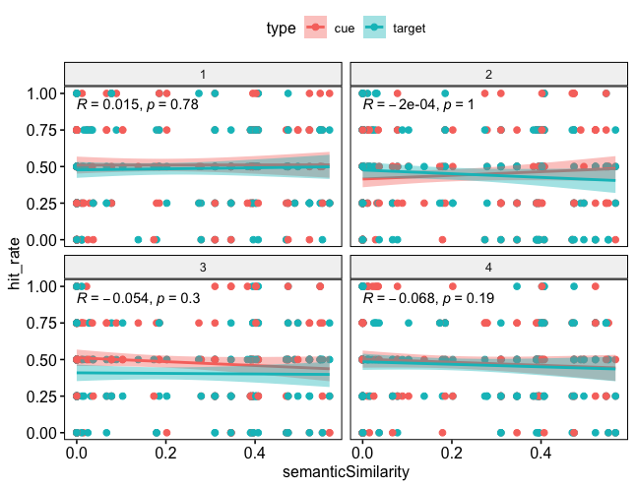
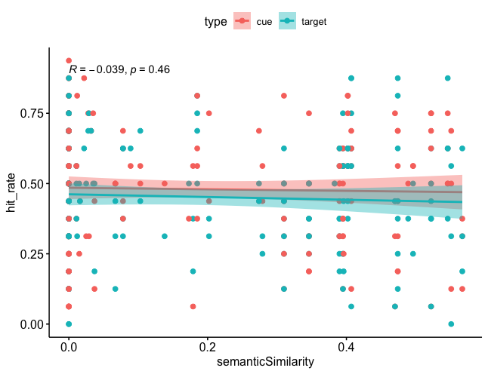
Regression analysis : semantic similarity level as a predictor for the Memory Task Hit_Rate. n = 47
Type III Analysis of Variance Table with Satterthwaite's method
Sum Sq Mean Sq NumDF DenDF F value Pr(>F)
type 0.001600 0.001600 1 1450.0 0.0225 0.8808
q 0.002645 0.002645 1 1450.0 0.0372 0.8471
semanticSimilarity 0.068467 0.068467 1 1455.2 0.9627 0.3267
type:q 0.036335 0.036335 1 1450.0 0.5109 0.4749
type:semanticSimilarity 0.027366 0.027366 1 1450.0 0.3848 0.5352
q:semanticSimilarity 0.142302 0.142302 1 1450.0 2.0008 0.1574
type:q:semanticSimilarity 0.020571 0.020571 1 1450.0 0.2892 0.5908
Type III Analysis of Variance Table with Satterthwaite's method
Sum Sq Mean Sq NumDF DenDF F value Pr(>F)
type 0.0269387 0.0269387 1 326.02 0.8705 0.3515
semanticSimilarity 0.0110098 0.0110098 1 337.33 0.3558 0.5513
type:semanticSimilarity 0.0017852 0.0017852 1 326.02 0.0577 0.8103

Slide 5
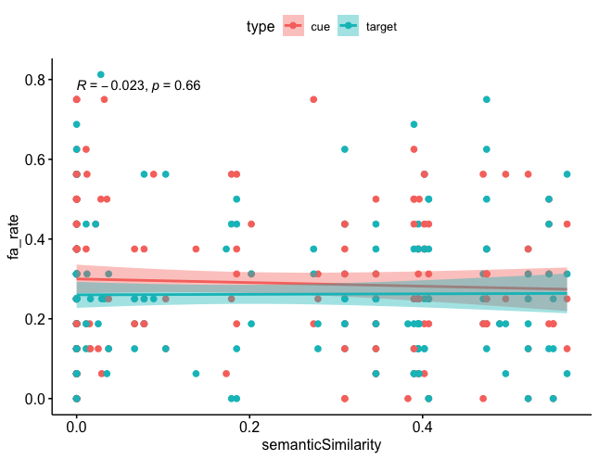
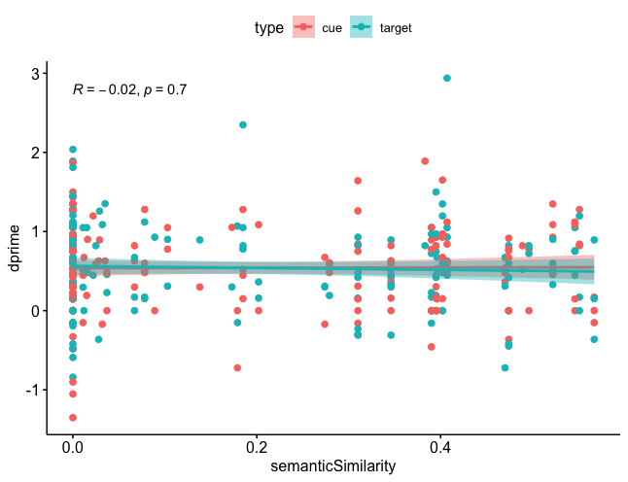
Regression analysis : semantic similarity level as a predictor for the Memory Task Fa_Rate & dprime. n = 47
Type III Analysis of Variance Table with Satterthwaite's method
Sum Sq Mean Sq NumDF DenDF F value Pr(>F)
type 0.079719 0.079719 1 326.01 3.7743 0.05291 .
semanticSimilarity 0.000520 0.000520 1 335.08 0.0246 0.87536
type:semanticSimilarity 0.010654 0.010654 1 326.01 0.5044 0.47808
Type III Analysis of Variance Table with Satterthwaite's method
Sum Sq Mean Sq NumDF DenDF F value Pr(>F)
type 0.036134 0.036134 1 326.08 0.1325 0.7161
semanticSimilarity 0.047016 0.047016 1 353.38 0.1724 0.6783
type:semanticSimilarity 0.076925 0.076925 1 326.08 0.2820 0.5957

Slide 6
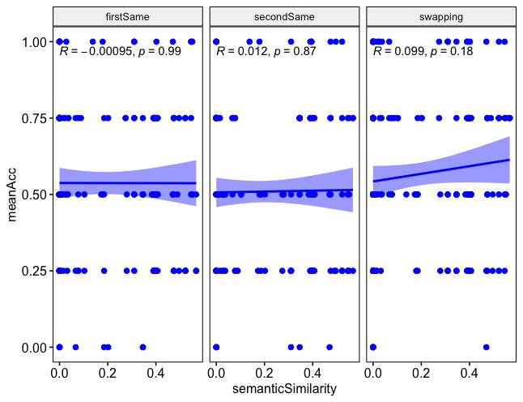
Regression analysis : semantic similarity level as a predictor for the Order Task. n = 47
Type III Analysis of Variance Table with Satterthwaite's method
Sum Sq Mean Sq NumDF DenDF F value Pr(>F)
semanticSimilarity 0.032506 0.032506 1 539.70 0.5587 0.4551
scrambleType 0.075772 0.037886 2 512.01 0.6511 0.5219
semanticSimilarity:scrambleType 0.074919 0.037459 2 512.01 0.6438 0.5257

Slide 7
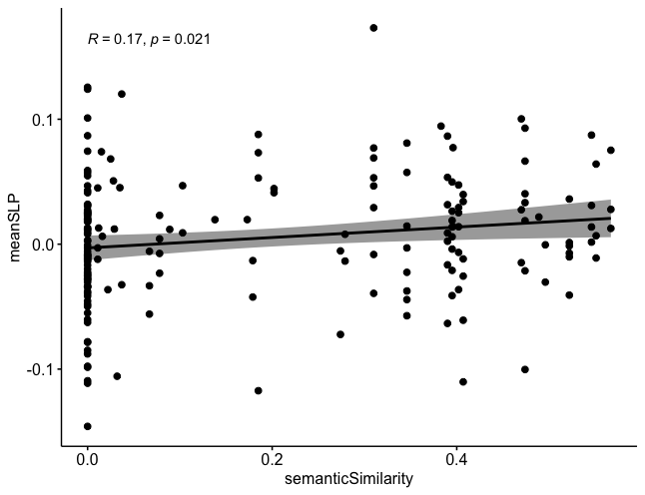
Regression analysis : semantic similarity level as a predictor for the SLP. n = 47

Slide 8
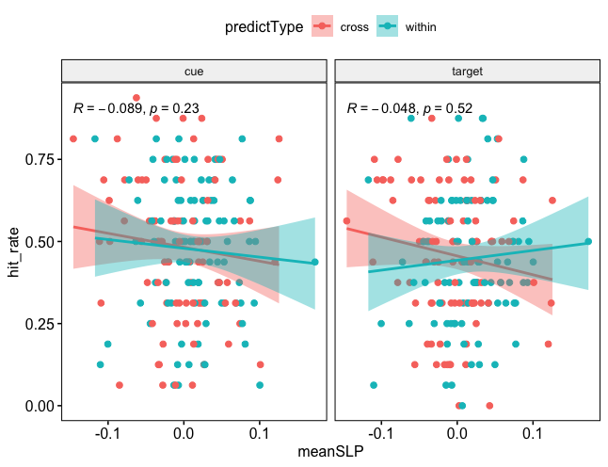
Regression analysis : SLP as a predictor for the Memory Task Hit_rate. n = 47
Type III Analysis of Variance Table with Satterthwaite's method
Sum Sq Mean Sq NumDF DenDF F value Pr(>F)
type 0.089155 0.089155 1 322.11 2.8921 0.08998 .
predictType 0.003217 0.003217 1 324.63 0.1043 0.74688
meanSLP 0.082737 0.082737 1 357.83 2.6839 0.10225
type:predictType 0.002231 0.002231 1 322.11 0.0724 0.78807
type:meanSLP 0.010250 0.010250 1 322.11 0.3325 0.56460
predictType:meanSLP 0.024653 0.024653 1 354.53 0.7997 0.37179
type:predictType:meanSLP 0.029830 0.029830 1 322.11 0.9676 0.32601

Slide 9
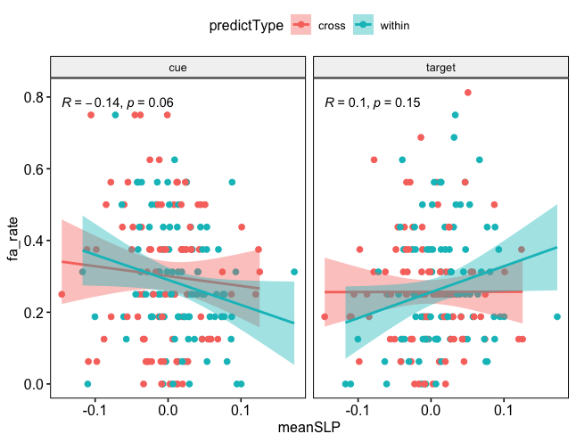
Regression analysis : SLP as a predictor for the Memory Task Fa_rate. n = 47
Type III Analysis of Variance Table with Satterthwaite's method
Sum Sq Mean Sq NumDF DenDF F value Pr(>F)
type 0.138553 0.138553 1 322.12 6.7397 0.009861 **
predictType 0.005079 0.005079 1 324.13 0.2470 0.619501
meanSLP 0.000019 0.000019 1 351.97 0.0009 0.976060
type:predictType 0.002168 0.002168 1 322.12 0.1055 0.745579
type:meanSLP 0.168398 0.168398 1 322.12 8.1914 0.004484 **
predictType:meanSLP 0.017215 0.017215 1 348.85 0.8374 0.360778
type:predictType:meanSLP 0.076097 0.076097 1 322.12 3.7016 0.055241 .

Slide 10
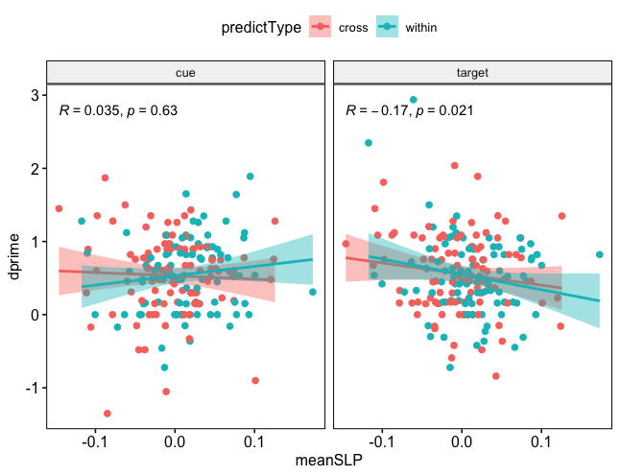
Regression analysis : SLP as a predictor for the Memory Task dprime. n = 47
Type III Analysis of Variance Table with Satterthwaite's method
Sum Sq Mean Sq NumDF DenDF F value Pr(>F)
type 0.04143 0.04143 1 320.27 0.1543 0.69470
predictType 0.00061 0.00061 1 325.65 0.0023 0.96201
meanSLP 0.64010 0.64010 1 363.15 2.3843 0.12343
type:predictType 0.00067 0.00067 1 320.27 0.0025 0.96030
type:meanSLP 1.15020 1.15020 1 320.27 4.2844 0.03926 *
predictType:meanSLP 0.01637 0.01637 1 366.81 0.0610 0.80512
type:predictType:meanSLP 0.31149 0.31149 1 320.27 1.1603 0.28222

Slide 11
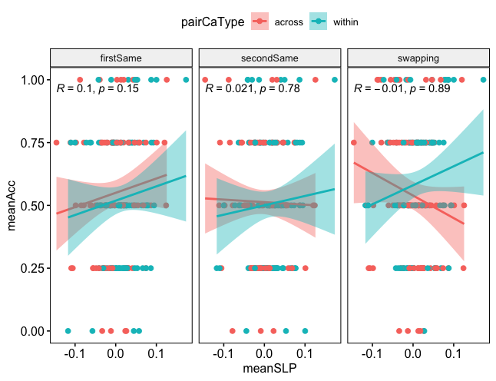
Regression analysis : SLP as a predictor for the Order Task. n = 47
Type III Analysis of Variance Table with Satterthwaite's method
Sum Sq Mean Sq NumDF DenDF F value Pr(>F)
scrambleType 0.252993 0.126497 2 505.40 2.1776 0.1144
pairCaType 0.000366 0.000366 1 511.77 0.0063 0.9367
meanSLP 0.007878 0.007878 1 542.72 0.1356 0.7128
scrambleType:pairCaType 0.126331 0.063165 2 505.40 1.0874 0.3379
scrambleType:meanSLP 0.099315 0.049657 2 505.40 0.8548 0.4260
pairCaType:meanSLP 0.124803 0.124803 1 548.65 2.1484 0.1433
scrambleType:pairCaType:meanSLP 0.168925 0.084462 2 505.40 1.4540 0.2346

Slide 12
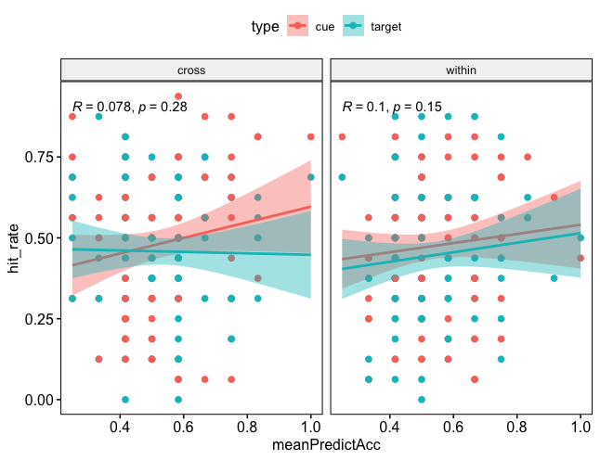
Regression analysis : Order test Score as a predictor for the Memory Task Hit_rate. n = 47
Type III Analysis of Variance Table with Satterthwaite's method
Sum Sq Mean Sq NumDF DenDF F value Pr(>F)
type 0.011154 0.011154 1 322.08 0.3665 0.54535
predictType 0.004775 0.004775 1 351.00 0.1569 0.69227
meanPredictAcc 0.180840 0.180840 1 355.91 5.9418 0.01527 *
type:predictType 0.034371 0.034371 1 322.08 1.1293 0.28872
type:meanPredictAcc 0.033055 0.033055 1 322.08 1.0861 0.29812
predictType:meanPredictAcc 0.001949 0.001949 1 352.33 0.0640 0.80036
type:predictType:meanPredictAcc 0.035960 0.035960 1 322.08 1.1815 0.27786

Slide 13
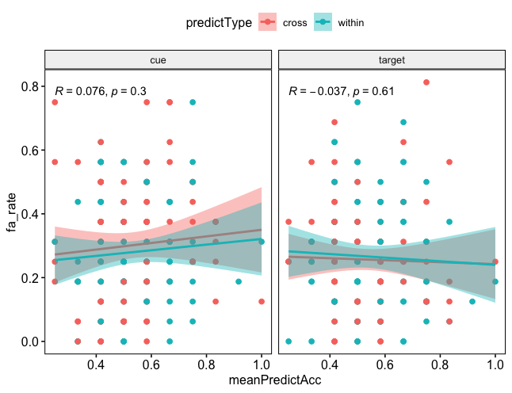
Regression analysis : Order test Score as a predictor for the Memory Task Fa_rate. n = 47
Type III Analysis of Variance Table with Satterthwaite's method
Sum Sq Mean Sq NumDF DenDF F value Pr(>F)
type 0.013001 0.013001 1 321.47 0.6252 0.42972
predictType 0.000336 0.000336 1 345.43 0.0162 0.89895
meanPredictAcc 0.085339 0.085339 1 365.84 4.1035 0.04352 *
type:predictType 0.002202 0.002202 1 321.47 0.1059 0.74508
type:meanPredictAcc 0.038550 0.038550 1 321.47 1.8537 0.17431
predictType:meanPredictAcc 0.001251 0.001251 1 346.60 0.0601 0.80642
type:predictType:meanPredictAcc 0.000056 0.000056 1 321.47 0.0027 0.95866

Slide 14
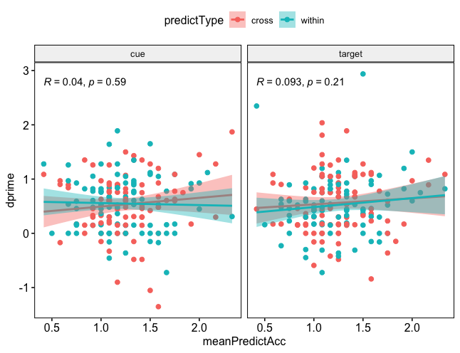
Regression analysis : Order test Score as a predictor for the Memory Task dprime. n = 47
ype III Analysis of Variance Table with Satterthwaite's method
Sum Sq Mean Sq NumDF DenDF F value Pr(>F)
type 0.06351 0.06351 1 322.32 0.2307 0.6313
predictType 0.04312 0.04312 1 367.27 0.1566 0.6925
meanPredictAcc 0.34604 0.34604 1 219.42 1.2569 0.2635
type:predictType 0.24144 0.24144 1 322.32 0.8770 0.3497
type:meanPredictAcc 0.07017 0.07017 1 322.32 0.2549 0.6140
predictType:meanPredictAcc 0.05908 0.05908 1 365.74 0.2146 0.6435
type:predictType:meanPredictAcc 0.18850 0.18850 1 322.32 0.6847 0.4086

Slide 15
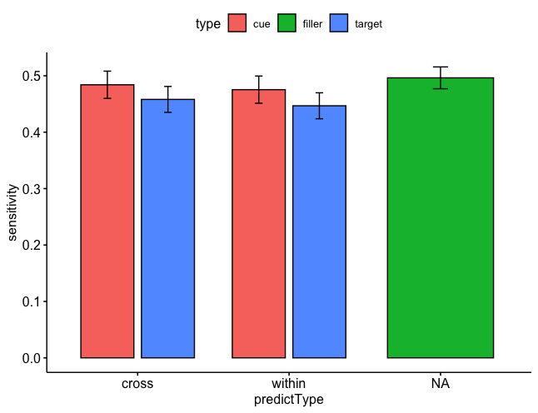
Mixed-effect Model : memory test hit_rate
Type III Analysis of Variance Table with Satterthwaite's method
Sum Sq Mean Sq NumDF DenDF F value Pr(>F)
type 0.034928 0.034928 1 138 2.1578 0.1441
predictType 0.004675 0.004675 1 138 0.2888 0.5918
type:predictType 0.000083 0.000083 1 138 0.0051 0.9430

